Slide 1
P01 Mathagym 6th Presentation
A113 – Mathematics

Slide 2

Strategy in games
There are many strategies that a team can adopt in a game. The strategies will depend on the rules of the game as well as the strengths and weaknesses of team members.
In today’s problem, we looked at limitations such as time given to answer questions, type of questions that needs to be answered and the number of points that a team can score from it.
Most of the types of questions in the game today requires some knowledge of Algebra to solve them.

Slide 3
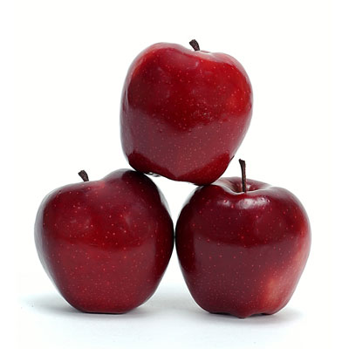
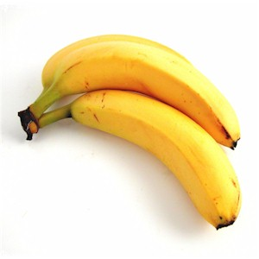
Algebra
Algebra is the branch of elementary mathematics which uses variables (usually letters, like x, y or z) to represent unknown quantities.
It consists of making expressions or manipulating equations which contain symbols, variables as well as numbers and functions.
Example
Mariam has 3 apples and 2 bananas. The weight of one apple is A units and the weight of one banana is B units. The total weight can be expressed in algebra as:

Slide 4
Equality
In Algebra the concept of equality brings about equations. It is a mathematical statement to show that two expressions are equal.
The weighing scale balance is one way to show how the weight of objects can be equal to each other.
Example
Mariam has 3 apples and 2 bananas that weighs 50 units in total. The weight of one apple is A units and the weight of one banana is B units. This can be expressed as an equation:

Slide 5
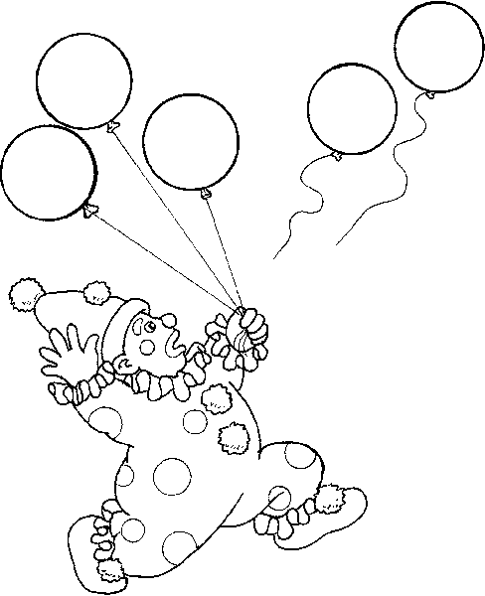
Equations in Algebra
Algebra is about finding the unknown or putting real life problems into equations and then solving them.
Example
A clown was carrying a handful of balloons. Along came the wind and blew 2 away, leaving him only with 3. Form an algebraic equation to represent the above scenario?
In algebra, this problem would then be
converted to the equation
where x represents the number of balloons
the clown had initially.

Slide 6
Sequence of operations
The sequence of operations in which one is to interpret a mathematical expression or equation is a convention (i.e. decided by people as a standard for easy communication).
In the modern society, we usually make use of this convention for operations: (BODMAS rule)
Brackets (or “Parentheses”)
Exponentiation (or “Power” or “Order”)
Division and Multiplication, left to right
Addition and Subtraction, left to right

Slide 7
Sequence of operations
Convention for Operations:
Brackets (or “Parentheses”)
Exponentiation (or “Power”)
Division and Multiplication, left to right
Addition and Subtraction, left to right
Example

Slide 8
Solving Algebraic Equations
In order to find the unknown variable in an algebraic equation, we can isolate the variable to one side of the equation.
To do this, we can manipulate the expressions in algebra is by applying similar operations to both sides of the equation so that it remains ‘balanced’.
Example:

Slide 9
Solving Algebraic Equations
Example

Slide 10
Use of Exponent (^)
Exponent (also known as “power”) is a number or variable or expression that represents the number of times the base is multiplied by itself.
Example:
An expression with an exponent in it can still be solved through algebraic manipulation.
Example:

Slide 11
Law of Indices
Product Law:
Quotient Law:
Power Law:
Fraction Law:
Root Law:

Slide 12
Law of Indices - Examples
Simply and Evaluate the following expression

Slide 13
Worked Example (Practice Questions Q3c)
Find the value of x

Slide 14
Worked Example (Practice Questions Q6c)
Express x in terms of y

Slide 15
Worked Example (Practice Questions Q7b)
Find the value of x

Slide 16
Learning Objectives
Simplify and evaluate numerical or algebraic expressions (including with brackets)
Manipulate and evaluate numerical and algebraic expressions that involve ratio and proportion
Apply operations to simplify and evaluate expression.
Simplify and evaluate numerical and algebraic expressions that involve indices

Slide 17
Exploring Further

